Slide 1
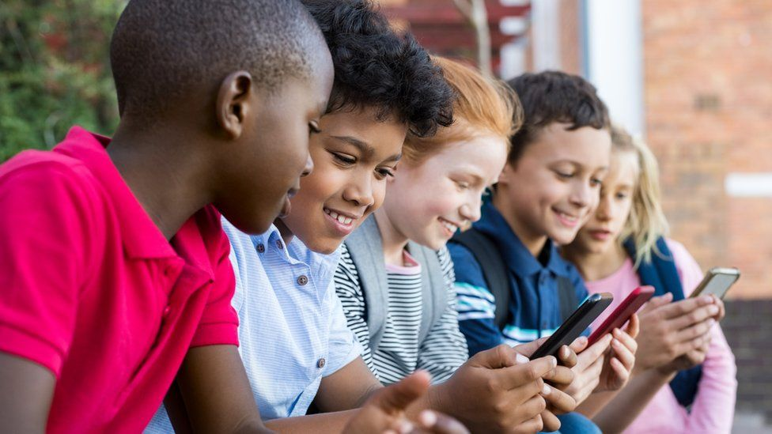
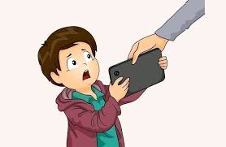
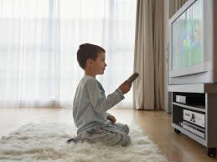
Saving screen time
JOSO Junior Online Safety Officer

Slide 2
How much time do you spend on your phone/tablet?

Slide 3
Alternatives to screen time:
Play with pets (if you have one)
Read a book
Draw characters from a game or make a poster for the game
Make a book
Play a board games
Ride a bike or scooter or skateboard
Go to the park (ask for permission)

Slide 4
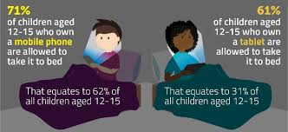
Did you know?
Children aged eight to 11 who used screens for fun for less than two hours a day performed better in tests of mental ability, a study found
kids ages 8-18 now spend, on average, a whopping 7.5 hours in front of a screen
51 percent of children went outside to walk or play once a day with either parent
Per day, children spend over seven hours on screens and less than 10 minutes engaging in unstructured outdoor play.

Slide 5
Quiz?
What percent do kids actually went out side to play or go on a walk?
51%
What alternatives are there that we recommended for you?
Play with pets (if you have one)
Read a book
Draw characters from a game or make a poster for the game
Make a book
Play a board games
Ride a bike or scooter or skateboard
Go to the park (ask for permission)
What ages spend a whopping 7.5 hours on a screen?
kids ages 8-18

